Slide 1

Document Tag Generator
GROUP - 08
GUNATHILAKA R.M.SM - E/17/100
PERERA K.S.D - E/17/246
RATHNAYAKA R.L.D.A.S - E/17/284
PRODUCT OWNER - MR. NUWAN JALIYAGODA

Slide 2

What is a Tag?
A KEYWORD OR TERM ASSIGNED TO A PIECE OF INFORMATION

Slide 3


PROBLEM DIAGNOSIS

Slide 4
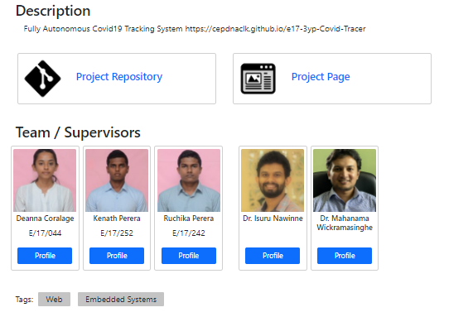
There are nearly 150 projects in the department website.
Problems
Some projects contain tags but some doesn’t.
Hard to manually categorize the projects.
Hard to search for a project using tags.
Project website - : https://projects.ce.pdn.ac.lk

Slide 5


OUR SOLUTION
GENERATE TAGS FOR THE PROJECTS IN THE DEPARTMENT WEBSITE

Slide 6
Extract data from the API portals
Convert data into specific format using parallel processing
Implement a model that generates the tags
Integrate the model into the API endpoint.

Slide 7




Impact of the Solution
Searching for a project would be easy.
Suggesting similar projects, when visiting a project.
No need of manually adding tags to the project.
Projects will be categorized in different ways.

Slide 8
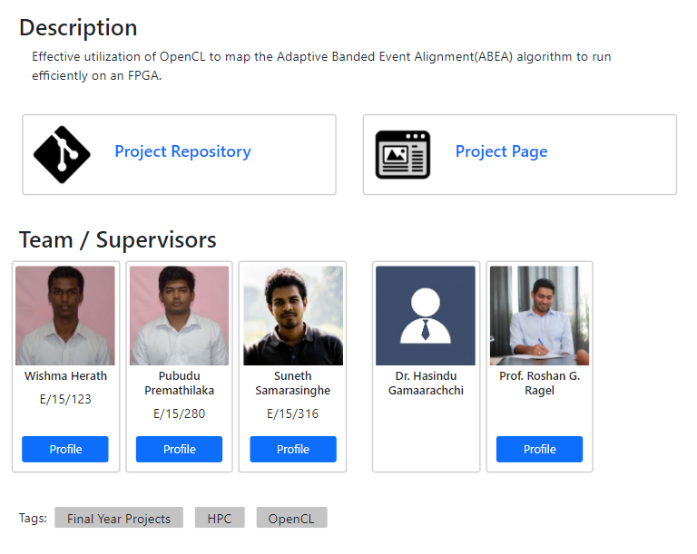

END PRODUCT
INTEGRATED MODEL IN THE API
Integrate the model into the department project site API to generate tags automatically.
Execute the model periodically.
OPTIONAL REQUIREMENT
Integrate the model into a GitHub action

Slide 9

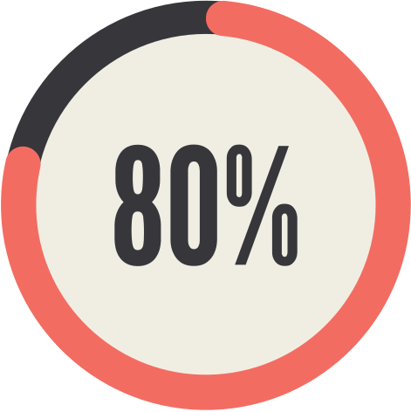
Evaluation of the Model
Need to label the data manually.
80% success rate is sufficient.

Slide 10




LIMITED DATA
DESCRIPTIONS MAY NOT ACCURATE.
Key Problems
LABELED TAGS MAY BE IRRELEVANT
NEED A MANUAL DATA LABELING

Slide 11
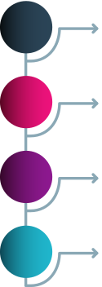
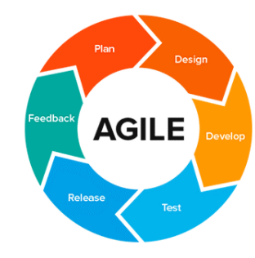

Plan Of Work
Requirement analyzing and system analyzing.
Gather data and convert them into specific formats.
Implementation of the model and integration with API.
Testing
Deployment and Maintenance

Slide 12
TEAM
R.M.S.M. GUNATHILAKA
E/17/100
K.S.D. PERERA
E/17/246
R.L.D.A.S. RATHNAYAKA
E/17/284
Front End
Back End
Tensorflow
Cloud Computing
Front End
Back End
Tensorflow
Cloud Computing.
Front End
Back End
Tensorflow
Cloud Computing

Slide 13

QUESTIONS

Slide 14


